Slide 1




Noida Institute of Engineering and Technology, Greater Noida
ARTIFICIAL NEURAL NETWORKS
Unit: 4
Subject Name:
ACSML0401
Machine Learning Techniques
Faculty Details:
Alisha Sikri
Assistant professor
AIML Department
Course Details: B.tech IV sem

Slide 2

Faculty Profile
Noida Institute of Engineering and Technology, Greater Noida
Name: Alisha Sikri
Qualification: PhD (Pursuing)
Specialization Areas: Machine Learning, Artificial Intelligence
COURSE | BOARD/UNIVERSITY | YEAR OF PASSING
PhD | SRM University, NCR | Pursuing
M.Tech | DCRUST University, Murthal | 2016
B.Tech | MDU, Rohtak | 2014

Slide 3

Faculty Profile
COURSE | BOARD/UNIVERSITY | YEAR OF PASSING
Phd | SRM University, NCR | Pursuing
M.Tech | DCRUST University, Murthal | 2016
B.Tech | MDU, Rohtak | 2010

Slide 4
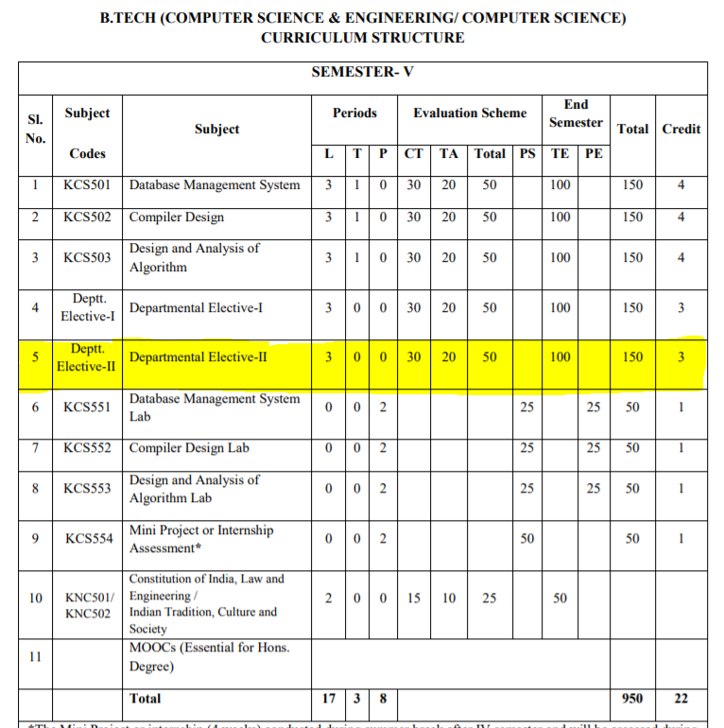
Evaluation Scheme

Slide 5
Syllabus
Unit-I : Introduction-
Learning, Types of Learning, Well defined learning problems, Designing a Learning System, History of ML, Introduction of Machine Learning Approaches – (Artificial Neural Network, Clustering, Reinforcement Learning, Decision Tree Learning, Bayesian networks, Support Vector Machine, Genetic Algorithm), Issues in Machine Learning and Data Science Vs Machine Learning
Unit-II : REGRESSION:
Linear Regression and Logistic Regression BAYESIAN LEARNING - Bayes theorem, Concept learning, Bayes Optimal Classifier, Naïve Bayes classifier, Bayesian belief networks, EM algorithm. SUPPORT VECTOR MACHINE: Introduction, Types of support vector kernel – (Linear kernel, polynomial kernel,and Gaussiankernel), Hyperplane – (Decision surface), Properties of SVM, and Issues in SVM.
Unit-III : DECISION TREE LEARNING - Decision tree learning algorithm, Inductive bias, Inductive inference with decision trees, Entropy and information theory, Information gain, ID-3 Algorithm, Issues in Decision tree learning. INSTANCE-BASED LEARNING – k-Nearest Neighbour Learning, Locally Weighted Regression, Radial basis function networks, Case-based learning.

Slide 6
Syllabus
Unit-IV : ARTIFICIAL NEURAL NETWORKS –
Perceptron’s, Multilayer perceptron, Gradient descent and the Delta rule, Multilayer networks, Derivation of Backpropagation Algorithm, Generalization, Unsupervised Learning – SOM Algorithm and its variant; DEEP LEARNING - Introduction,concept of convolutional neural network , Types of layers – (Convolutional Layers , Activation function , pooling , fully connected) , Concept of Convolution (1D and 2D) layers, Training of network, Case study of CNN for eg on Diabetic Retinopathy, Building a smart speaker, Self-deriving car etc..
Unit-V : REINFORCEMENT LEARNING–Introduction to Reinforcement Learning , Learning Task,Example of Reinforcement Learning in Practice, Learning Models for Reinforcement – (Markov Decision process , Q Learning - Q Learning function, Q Learning Algorithm ), Application of Reinforcement Learning,Introduction to Deep Q Learning. GENETIC ALGORITHMS: Introduction, Components, GA cycle of reproduction, Crossover, Mutation, Genetic Programming, Models of Evolution and Learning, Applications

Slide 7
Branch wise Application
Virtual Personal Assistants
Predictions while Commuting
Videos Surveillance
Social Media Services
Email Spam and Malware Filtering
Online Customer Support
Search Engine Result Refining
Product Recommendations
Online Fraud Detection

Slide 8
Course Objectives
This course will serve as a comprehensive introduction to various topics in machine learning
To introduce students to the basic concepts and techniques of Machine Learning.
To become familiar with regression methods, classification methods, clustering methods.
To introduce the concept of Decision Tree Learning and Instance-based Learning
To become familiar with Artificial Neural Networks and Deep Learning
To introduce the concept of Reinforcement Learning and Genetic Algorithms

Slide 9
Course Outcomes
At the end of the course, the student should be able to
COURSE OUTCOME NO | COURSE OUTCOMES
CO1 | To understand the need for machine learning for various problem solving
CO2 | To understand a wide variety of learning algorithms and how to evaluate models generated from data
CO3 | To understand the latest trends in machine learning
CO4 | To design appropriate machine learning algorithms and apply the algorithms to a real-world problems
CO5 | To optimize the models learned and report on the expected accuracy that can be achieved by applying the models

Slide 10
Course Outcomes
1. Engineering knowledge
2. Problem analysis
3. Design/development of solutions
4. Conduct investigations of complex problems
5. Modern tool usage
6. The engineer and society
7. Environment and sustainability
8. Ethics
9. Individual and team work
10. Communication
11. Project management and finance
12. Life-long learning

Slide 11
CO-PO Mapping
CO MAPPING WITH PO
CO. No. | PO1 | PO2 | PO 3 | PO 4 | PO 5 | PO 6 | PO 7 | PO 8 | PO 9 | PO 10 | PO 11 | PO 12
1 | 3 | 3 | 3 | 1 |  |  |  |  | 1 |  |  | 2
2 | 3 | 3 | 3 | 1 |  |  |  |  | 1 |  |  | 1
3 | 3 | 3 | 3 | 1 |  | 1 |  |  | 1 |  |  | 1
4 | 3 | 3 | 3 | 1 |  |  |  |  | 1 |  |  | 2
5 | 3 | 3 | 3 | 2

Slide 12
Program Specific Outcome (PSO)
On successful completion of graduation degree, The computer Science & Engineering graduates will be able to:
PSO1: identify, analyze real world problems and design their ethical solutions using artificial intelligence, robotics, virtual/augmented reality, data analytics, block chain technology, and cloud computing.
PSO2: design and develop the hardware sensor devices and related interfacing software systems for solving complex engineering problems.
PSO 3: understand inter-disciplinary computing techniques and to apply them in the design of advanced computing.
PSO 4: conduct investigation of complex problem with the help of technical, managerial, leadership qualities, and modern engineering tools provided by industry sponsored laboratories.

Slide 13
CO-PSO Mapping
CO MAPPING WITH PSO
CO/PSO | POS1 | POS2 | POS3 | POS4
CO 1 | 3 | 1 | 1 | -
CO 2 | 3 | 2 | - | -
CO 3 | 3 | 2 | - | -
CO 4 | 3 | 2 | 2 | 1
CO 5 | 3 | 2 | 1 | -

Slide 14
PEOs
PEO 1: To have an excellent scientific and engineering breadth so as to comprehend, analyze, design and provide sustainable solutions for real-life problems using state-of-the-art technologies.
PEO 2: To have a successful career in industries, to pursue higher studies or to support entrepreneurial endeavors and to face the global challenges.
PEO 3:To have an effective communication skills, professional attitude, ethical values and a desire to learn specific knowledge in emerging trends, technologies for research, innovation and product development and contribution to society.
PEO 4: To have life-long learning for up-skilling and re-skilling for successful professional career as engineer, scientist, entrepreneur and bureaucrat for betterment of society.

Slide 15
CO-PSO Mapping
CO. NO. | PSO1 | PSO2 | PSO3 | PSO4
1 | 1 | 2
2 | 1 | 2 | 1 | 1
3 | 2 | 1 | 1 | 2
4 | 1 | 1 | 1 | 2
5 | 1 | 1 | 1

Slide 16
Result Analysis
MLT(KCS-055)
Subject wise result | 95.62
Faculty wise result | 92.65

Slide 17

End Sem Question Papers Format

Slide 18
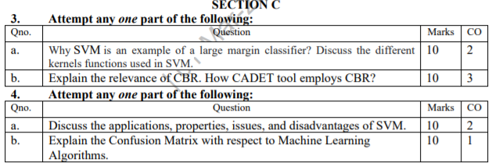
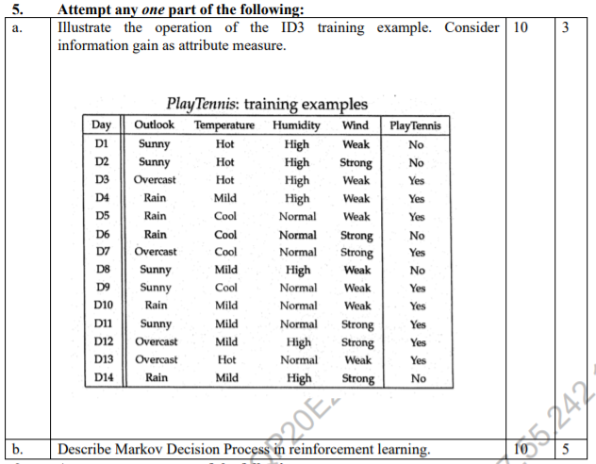
End Sem Question Papers Format

Slide 19
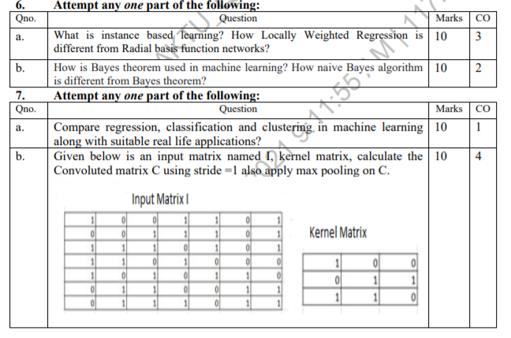
End Sem Question Papers Format

Slide 20
Prerequisite
To get started with Machine Learning you must be familiar with the following
concepts:
Algebra
variables, coefficients, and functions
linear equations such as y=b+w1x1+w2x2
logarithms, and logarithmic equations such as y=ln(1+ez)
sigmoid function
Linear algebra
tensor and tensor rank
matrix multiplication

Slide 21
Prerequisite
Trigonometry
Tan h (discussed as an activation function; no prior knowledge needed)
Calculus (optional, for advanced topics)
concept of a derivative (you won't have to actually calculate derivatives)
gradient or slope
partial derivatives (which are closely related to gradients)
chain rule (for a full understanding of the backpropagation algorithm for training neural networks)

Slide 22
Pre-requisite
Programming language:
It is essential to know programming languages like R and Python in order to implement the whole Machine Learning process. Python and R both provide in-built libraries that make it very easy to implement Machine Learning algorithms.

Slide 23
Contents
NEURAL NETWORK-
Neuron
Nerve structure and synapse
Artificial Neuron and its model
Activation
Functions
NEURAL NETWORK ARCHITECTURE:
single layer and multilayer feed forward networks
recurrent networks
various learning techniques
perception and convergence rule
Deep Learning
concept of convolutional neural network
Types of layers

Slide 24
Objectives of Unit
Mainly the Unit’s objectives are:
Conceptualization and summarization of ANN
To understand Computational complexity of training
To become familiar with basic Deep learning concepts

Slide 25
Unit Outcomes
Illustrate the fundamentals of computational learning theory with an understanding of the mistake bounds.
Construct learning algorithms which involves linear regression with a comprehension of regularization, bias-variance and evidence approximation.
Compare the available design options and apply supervised and unsupervised learning algorithms to solve complex problems with an understanding of the trade-offs involved.

Slide 26
Mapping
NEURAL NETWORK (CO4)
NEURAL NETWORK ARCHITECTURE (CO4)
DEEP LEARNING (CO4)

Slide 27
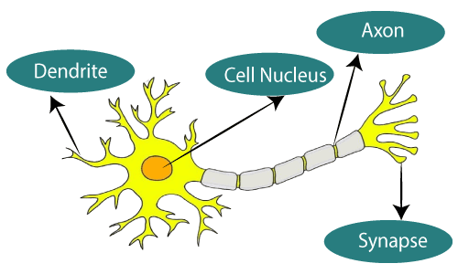
NEURAL NETWORK
The term "Artificial Neural Network" is derived from Biological neural networks that develop the structure of a human brain. Similar to the human brain that has neurons interconnected to one another, artificial neural networks also have neurons that are interconnected to one another in various layers of the networks. These neurons are known as nodes.

Slide 28
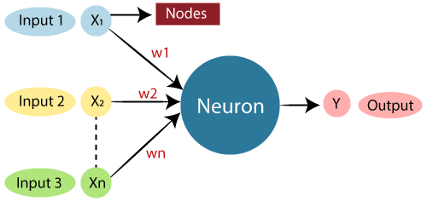
NEURAL NETWORK
The typical Artificial Neural Network looks something like the given figure.

Slide 29
NEURAL NETWORK
Relationship between Biological neural network and artificial neural network:
Biological Neural Network | Artificial Neural Network
Dendrites | Inputs
Cell nucleus | Nodes
Synapse | Weights
Axon | Output

Slide 30
COMPARISON BETWEEN ANN AND BNN
Criteria | BNN | ANN
Processing | Massively parallel, slow but superior than ANN | Massively parallel, fast but inferior than BNN
Size | 10¹¹ neurons and 10¹⁵ interconnections | 10² to 10⁴ nodes mainly depends on the type of application and network designer mainly depends on the type of application and network designer
Learning | They can tolerate ambiguity | Very precise, structured and formatted data is required to tolerate ambiguity
Fault tolerance | Performance degrades with even partial damage | It is capable of robust performance, hence has the potential to be fault tolerant
Storage capacity | Stores the information in the synapse | Stores the information in continous memory location

Slide 31
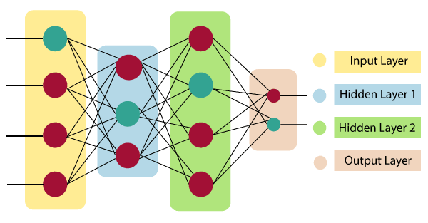
ARCHITECTURE OF AN ARTIFICIAL NEURAL NETWORK
Artificial Neural Network primarily consists of three layers:
Input Layer:
As the name suggests, it accepts inputs in several different formats provided by the programmer.

Slide 32
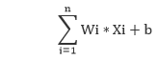
ARCHITECTURE OF AN ARTIFICIAL NEURAL NETWORK
Hidden Layer:
The hidden layer presents in-between input and output layers. It performs all the calculations to find hidden features and patterns.
Output Layer:
The input goes through a series of transformations using the hidden layer, which finally results in output that is conveyed using this layer.
The artificial neural network takes input and computes the weighted sum of the inputs and includes a bias. This computation is represented in the form of a transfer function.

Slide 33
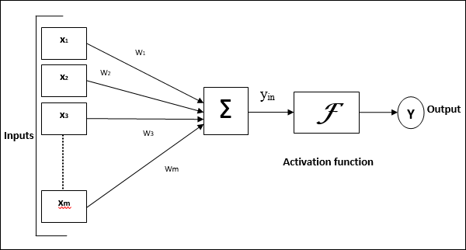
Model of Artificial Neural Network
The following diagram represents the general model of ANN followed by its processing.

Slide 34
Model of Artificial Neural Network
For the above general model of artificial neural network, the net input can be calculated as follows −
The output can be calculated by applying the activation function over the net input.
Y= F(yin)

Slide 35
ANN-BUILDING BLOCK
Processing of ANN depends upon the following three building blocks −
Network Topology
Adjustments of Weights or Learning
Activation Functions

Slide 36
NETWORK TOPOLOGY
A network topology is the arrangement of a network along with its nodes and connecting lines. According to the topology, ANN can be classified as the following kinds −
1. Feedforward Network
It is a non-recurrent network having processing units/nodes in layers and all the nodes in a layer are connected with the nodes of the previous layers. The connection has different weights upon them. There is no feedback loop means the signal can only flow in one direction, from input to output.

Slide 37
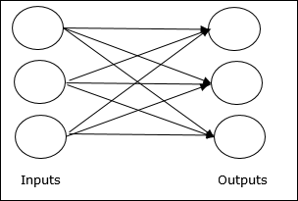
TYPES OF FEED FORWARD NETWORK
It may be divided into the following two types −
Single layer feedforward network − The concept is of feedforward ANN having only one weighted layer. In other words, we can say the input layer is fully connected to the output layer.

Slide 38
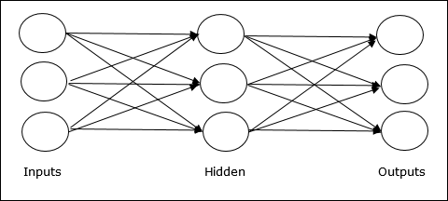
TYPES OF FEED FORWARD NETWORK
Multilayer feedforward network − The concept is of feedforward ANN having more than one weighted layer. As this network has one or more layers between the input and the output layer, it is called hidden layers.

Slide 39
NETWORK TOPOLOGY
2. Feedback Network
As the name suggests, a feedback network has feedback paths, which means the signal can flow in both directions using loops. This makes it a non-linear dynamic system, which changes continuously until it reaches a state of equilibrium.
It may be divided into the following types −
Recurrent networks − They are feedback networks with closed loops. Following are the two types of recurrent networks.

Slide 40
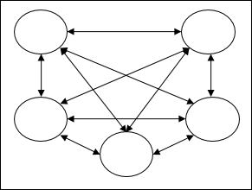
NETWORK TOPOLOGY
Fully recurrent network − It is the simplest neural network architecture because all nodes are connected to all other nodes and each node works as both input and output.

Slide 41
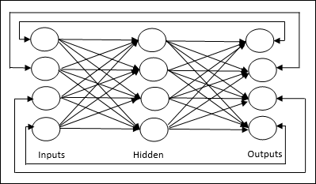
NETWORK TOPOLOGY
Jordan network − It is a closed loop network in which the output will go to the input again as feedback as shown in the following diagram.

Slide 42
ACTIVATION FUNCTION
It may be defined as the extra force or effort applied over the input to obtain an exact output. In ANN, we can also apply activation functions over the input to get the exact output. Followings are some activation functions of interest −
Linear Activation Function
It is also called the identity function as it performs no input editing. It can be defined as −
F(x)=x

Slide 43
ACTIVATION FUNCTION
2. Sigmoid Activation Function
It is of two type as follows −
Binary sigmoidal function − This activation function performs input editing between 0 and 1. It is positive in nature. It is always bounded, which means its output cannot be less than 0 and more than 1. It is also strictly increasing in nature, which means more the input higher would be the output. It can be defined as
F(x)= sigm(x) = 1
1+exp(−x)

Slide 44
ACTIVATION FUNCTION
Bipolar sigmoidal function − This activation function performs input editing between -1 and 1. It can be positive or negative in nature. It is always bounded, which means its output cannot be less than -1 and more than 1.

Slide 45
TYPES OF NEURAL NETWROK
There are many types of neural networks available or that might be in the development stage. They can be classified depending on their: Structure, Data flow, Neurons used and their density, Layers and their depth activation filters etc.
A. Perceptron
Perceptron model, proposed by Minsky-Papert is one of the simplest and oldest models of Neuron.
It is the smallest unit of neural network that does certain computations to detect features or business intelligence in the input data.
It accepts weighted inputs, and apply the activation function to obtain the output as the final result. Perceptron is also known as TLU(threshold logic unit)

Slide 46
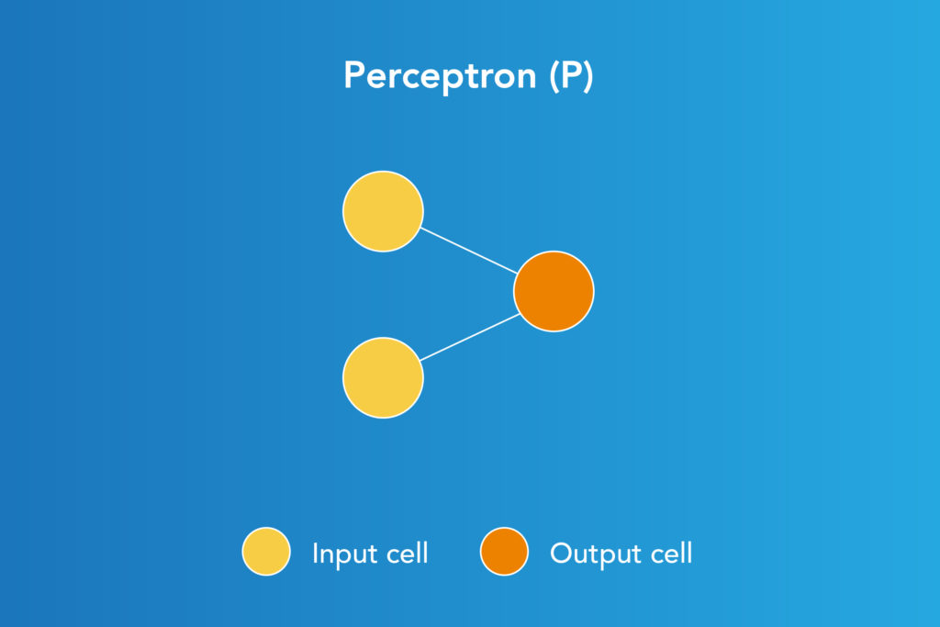
PERCEPTRON
Perceptron is a supervised learning algorithm that classifies the data into two categories, thus it is a binary classifier.
A perceptron separates the input space into two categories by a hyperplane represented by the following equation

Slide 47
PERCEPTRON
Advantages of Perceptron
Perceptron's can implement Logic Gates like AND, OR, or NAND
Disadvantages of Perceptron
Perceptron's can only learn linearly separable problems such as Boolean AND problem. For non-linear problems such as Boolean XOR problem, it does not work.

Slide 48
MULTILAYER PERCEPTRON
B. Multilayer Perceptron
An entry point towards complex neural nets where input data travels through various layers of artificial neurons.
Every single node is connected to all neurons in the next layer which makes it a fully connected neural network.
Input and output layers are present having multiple hidden Layers i.e. at least three or more layers in total.
It has a bi-directional propagation i.e. forward propagation and backward propagation.
Inputs are multiplied with weights and fed to the activation function and in backpropagation, they are modified to reduce the loss. In simple words, weights are machine learnt values from Neural Networks.

Slide 49
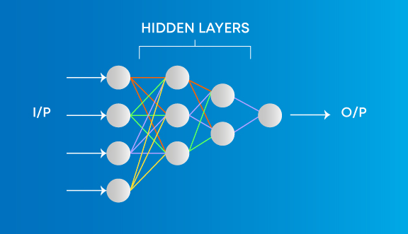
MULTILAYER PERCEPTRON
They self-adjust depending on the difference between predicted outputs vs training inputs. Nonlinear activation functions are used followed by softmax as an output layer activation function.

Slide 50
MULTILAYER PERCEPTRON
Advantages on Multi-Layer Perceptron
Used for deep learning [due to the presence of dense fully connected layers and back propagation]
Disadvantages on Multi-Layer Perceptron:
1. Comparatively complex to design and maintain
2. Comparatively slow (depends on number of hidden layer

Slide 51
CONVOLUTIONAL NEURAL NETWORK
C. . Convolutional Neural Network
Convolution neural network contains a three-dimensional arrangement of neurons, instead of the standard two-dimensional array.
The first layer is called a convolutional layer.
Each neuron in the convolutional layer only processes the information from a small part of the visual field.
Input features are taken in batch-wise like a filter. The network understands the images in parts and can compute these operations multiple times to complete the full image processing.
Processing involves conversion of the image from RGB or HSI scale to grey-scale. Furthering the changes in the pixel value will help to detect the edges and images can be classified into different categories.

Slide 52
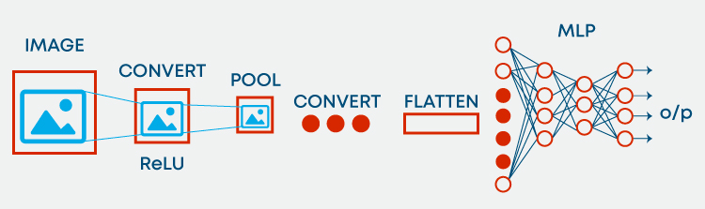
CONVOLUTIONAL NEURAL NETWORK

Slide 53
CONVOLUTIONAL NEURAL NETWORK
Advantages of Convolution Neural Network:
Used for deep learning with few parameters
Less parameters to learn as compared to fully connected layer
Disadvantages of Convolution Neural Network:
Comparatively complex to design and maintain
Comparatively slow [depends on the number of hidden layers]

Slide 54
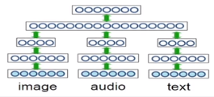
Deep Learning
Breakthrough results in
Image classification
Speech recognition
Machine Translation
Multi-model learning

Slide 55


Introduction
Can you recognize these pictures?
If yes, how do you recognize it?

Slide 56
Introduction
Descriptor/ Feature vector

Slide 57
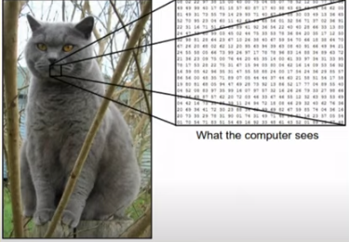
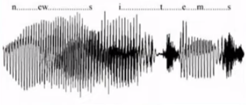
Introduction

Slide 58
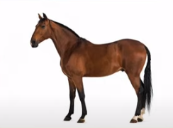
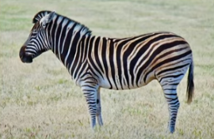
Descriptor/ Feature vector

Slide 59
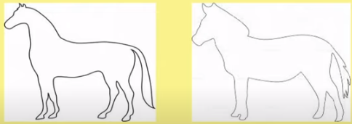
Descriptor/ Feature vector

Slide 60
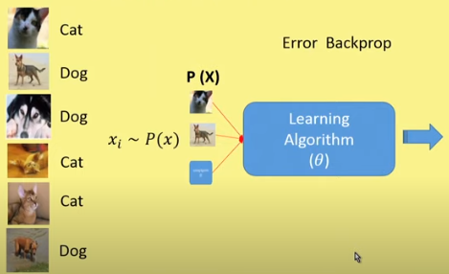
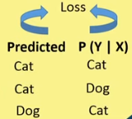
Discriminative model

Slide 61
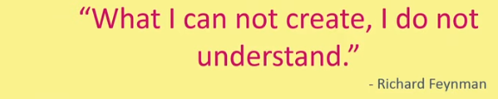

Generative model

Slide 62
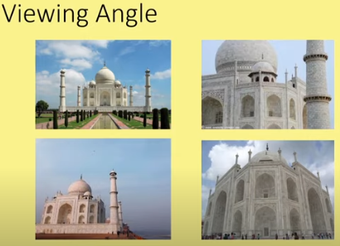
Challenges

Slide 63
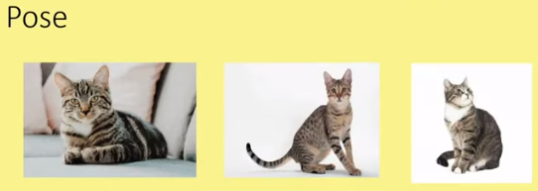

Challenges

Slide 64


Challenges

Slide 65
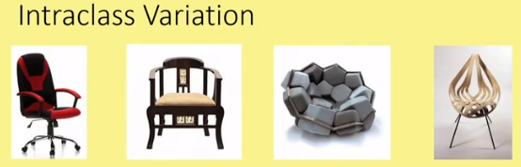

Challenges

Slide 66
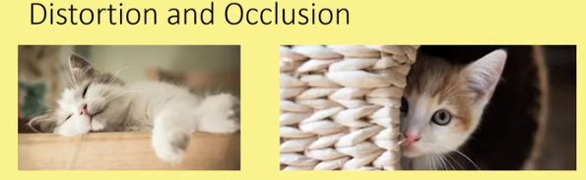

Challenges

Slide 67
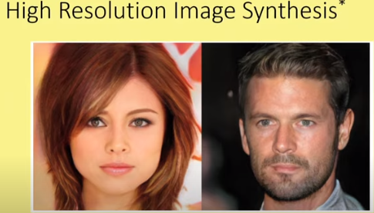
Power of Deep Learning
Source : NPTEL

Slide 68
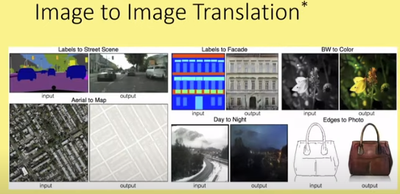
Power of Deep Learning

Slide 69
Power of Deep Learning

Slide 70
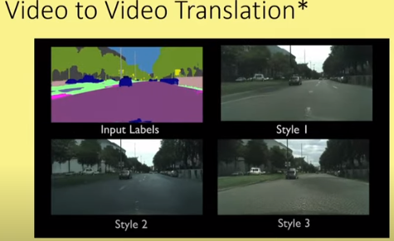
Power of Deep Learning

Slide 71
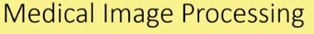
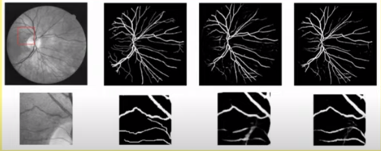
Power of Deep Learning

Slide 72
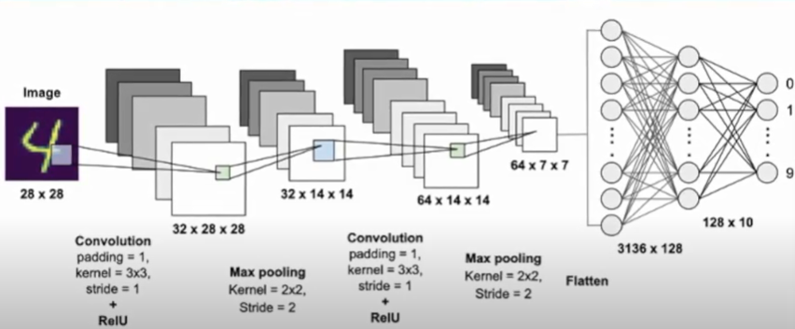
Convolutional Neural Networks

Slide 73
Convolutional Neural Networks
Building Blocks
Kernel
Detector
Stride
Padding
Pooling
Flatten

Slide 74
Convolutional Neural Networks
.
.
.
.
.
.
Image
Kernel
pooling
Kernel
pooling
Flatten
Feature Learning
Classification

Slide 75
Kernel
Kernel is filter used to extract features from the images.
Kernel is a matrix that moves over the input data, perform the dot product with sub-region of input data, and gets the outputs as the matrix of dot products.
Kernel moves on the input data by the stride value.

Slide 76

Kernel
1 0 1 0 1 0 1 0 1
Kernel/Filter, K
Size of feature map=(I-K) +1

Slide 77
Stride
The filter moved across the image left to right, top to bottom, with a one pixel column change on the horizontal movements, one pixel row change on vertical movements.
The amount of movement between applications of the filter to the input image is referred to as the de, and it is almost always symmetrical in height and width dimensions.
The default stride in two dimension is (1,1) for the height and width movement.

Slide 78

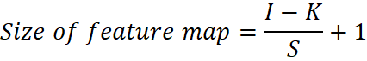
Stride
Convolution Operation with Stride Length = 2

Slide 79

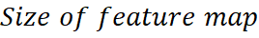
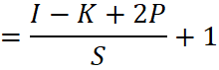
Padding
Fix the border effect problem with padding
5x5x1 image is padded with 0s to create a 6x6x1 image

Slide 80
Pooling
Similar to the Convolutional Layer, the Pooling layer is responsible for reducing the spatial size of the Convolved Feature.
This is to decrease the computational power required to process the data through dimensionality reduction.
Furthermore, it is useful for extracting dominant features which are rotational and positional invariant, thus maintaining the process of effectively training of the model.

Slide 81

Pooling
3x3 pooling over 5x5 convolved feature

Slide 82
Pooling
There are two types of Pooling: Max Pooling and Average Pooling.
Max Pooling returns the maximum value from the portion of the image covered by the Kernel.
On the other hand, Average Pooling returns the average of all the values from the portion of the image covered by the Kernel.
Max Pooling also performs as a Noise Suppressant. It discards the noisy activations altogether and also performs de-noising along with dimensionality reduction.
On the other hand, Average Pooling simply performs dimensionality reduction as a noise suppressing mechanism. Hence, we can say that Max Pooling performs a lot better than Average Pooling.

Slide 83
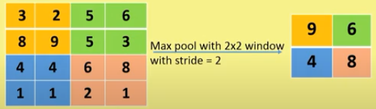
Pooling

Slide 84

Pooling

Slide 85
Convolutional Neural Network Architecture
CONVOLUTION
CONVOLUTION
IMAGE
POOLING
POOLING
FULLY CONNECTED LAYER
CLASS

Slide 86
Convolutional Neural Network
3 | 3 | 2 | 1 | 0
0 | 0 | 1 | 3 | 1
3 | 1 | 2 | 2 | 3
2 | 0 | 0 | 2 | 2
2 | 0 | 0 | 0 | 1
12 | 12 | 7
10 | 17 | 19
9 | 6 | 14
0 | 1 | 2
2 | 2 | 0
0 | 1 | 2

Slide 87
Convolutional Neural Network
3 | 3 | 2 | 1 | 0
0 | 0 | 1 | 3 | 1
3 | 1 | 2 | 2 | 3
2 | 0 | 0 | 2 | 2
2 | 0 | 0 | 0 | 1
0 | 1 | 2
2 | 2 | 0
0 | 1 | 2
12 | 7
9 | 14

Slide 88
Convolutional Neural Network
 | 3 | 3 | 2 | 1 | 0
 | 0 | 0 | 1 | 3 | 1
 | 3 | 1 | 2 | 2 | 3
 | 2 | 0 | 0 | 2 | 2
 | 2 | 0 | 0 | 0 | 1
0 | 0 | 0 | 0 | 0 | 0 | 0
0 | 3 | 3 | 2 | 1 | 0 | 0
0 | 0 | 0 | 1 | 3 | 1 | 0
0 | 3 | 1 | 2 | 2 | 3 | 0
0 | 2 | 0 | 0 | 2 | 2 | 0
0 | 2 | 0 | 0 | 0 | 1 | 0
0 | 0 | 0 | 0 | 0 | 0 | 0
3 | 3 | 2 | 1 | 0
0 | 0 | 1 | 3 | 1
3 | 1 | 2 | 2 | 3
2 | 0 | 0 | 2 | 2
2 | 0 | 0 | 0 | 1
0 | 1 | 2
2 | 2 | 0
0 | 1 | 2
6 | 14 | 17 | 11 | 3
14 | 12 | 12 | 17 | 11
5 | 10 | 17 | 19 | 13
11 | 9 | 6 | 14 | 12
6 | 4 | 4 | 6 | 4

Slide 89
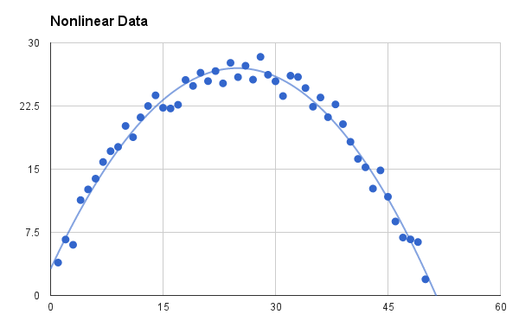
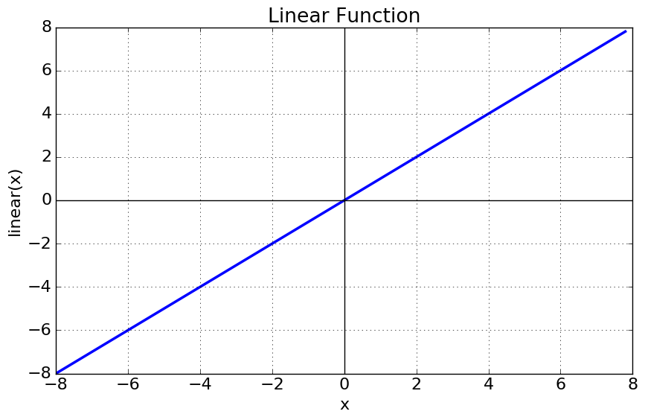
Activation functions
It is used to determine the output of neural network like yes or no. It maps the resulting values in between 0 to 1 or -1 to 1 etc. (depending upon the function).
The Activation Functions can be basically divided into 2 types-
Linear Activation Function
Non-linear Activation Functions

Slide 90
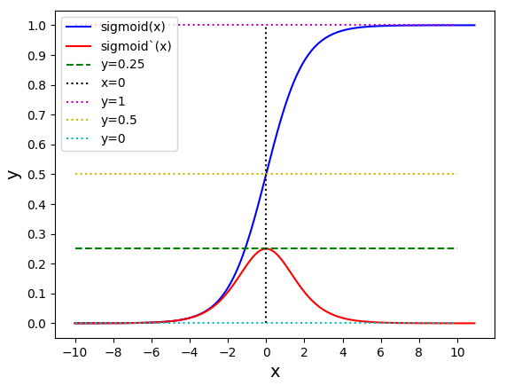
Sigmoid or Logistic Activation Function
it is especially used for models where we have to predict the probability as an output. Since probability of anything exists only between the range of 0 and 1
The function is differentiable

Slide 91
Sigmoid or Logistic Activation Function
it is especially used for models where we have to predict the probability as an output. Since probability of anything exists only between the range of 0 and 1
The function is differentiable

Slide 92
Vanishing Gradient
In vanishing gradient, the gradient becomes very small (close to 0) which leads to a very small change in weights (or almost no change).

Slide 93
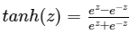
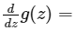
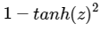
tanh activation function
This function is a shifted version of a sigmoid function but scaled between −1 and 1 . If we use a tanh as the activation function it almost always works better then sigmoid function because the mean of all possible values of this function is zero

Slide 94
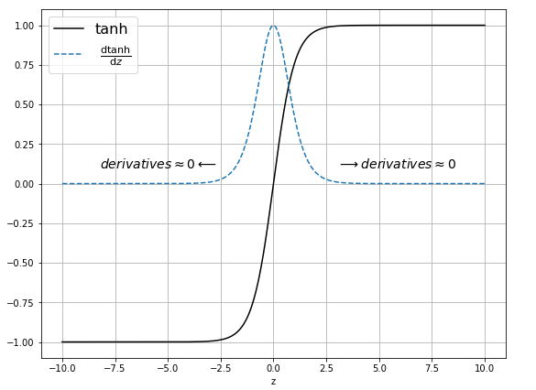
tanh activation function

Slide 95
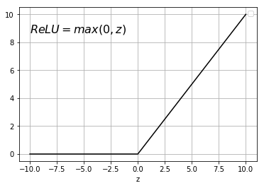
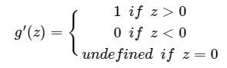
ReLU (Rectified Linear Unit) Activation Function
One other choice that is well known is ReLU function. This function is a commonly used activation function nowadays.
Derivatives of ReLU
A derivative of a ReLU function is:

Slide 96
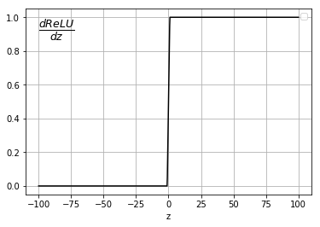
Derivative of ReLU Function

Slide 97
Leaky ReLU function
Leaky Relu is a variant of ReLU. Instead of being 0 when z<0, a leaky ReLU allows a small, non-zero, constant gradient α (Normally, α=0.01).
Leaky ReLUs are one attempt to fix the “dying ReLU” problem by having a small negative slope (of 0.01, or so)

Slide 98
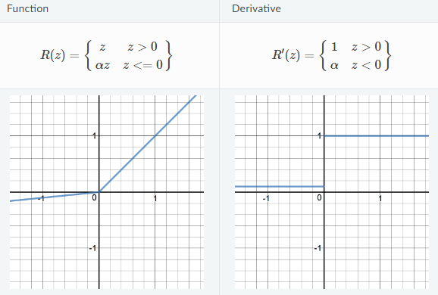
Leaky ReLU function

Slide 99
Faculty Video Links, Youtube & NPTEL Video Links and Online Courses Details
Youtube/Other Video Links:
1. Machine Learning by Prof. Balaraman ravindran, Department of computer science and engineering,IIT Madras (SWAYAM/NPTEL)
https://www.youtube.com/watch?v=fC7V8QsPBec&feature=youtu.be
2. Machine Learning by Prof. Sudeshna Sarkar, Department of computer science and engineering,IIT Kharagpur (NPTEL)
https://www.youtube.com/watch?v=EWmCkVfPnJ8&list=PLlGkyYYWOSOsGU-XARWdIFsRAJQkyBrVj&index=2
3. Machine learning UPGRAD course by IIIT,Bangalore
https://www.upgrad.com/machine-learning-ai-pgd-iiitb/

Slide 100
Daily Quiz
1. Which of the following option is true about k-NN algorithm?
It can be used for classification
It can be used for regression
It can be used in both classification and regression
2. Which of the following machine learning algorithm can be used for imputing missing values of both categorical and continuous variables?
K-NN
Linear Regression
C) Logistic Regression

Slide 101
Daily Quiz
3. Is it possible to design a logistic regression algorithm using a Neural Network Algorithm?
A) TRUE B) FALSE
4. Is it possible to apply a logistic regression algorithm on a 3-class Classification problem?
A) TRUE B) FALSE

Slide 102
Daily Quiz
5. In a Bayesian network variable is?
A. continuous B. discrete C. Both A and B D. None of the above
6. For what purpose Feedback neural networks are primarily used? a) classification b) feature mapping c) pattern mapping d) none of the mentioned
7. False minima can be reduced by deterministic updates? a) yes b) no

Slide 103
Daily Quiz
8. For practical implementation what type of approximation is used on boltzman law? a) max field approximation b) min field approximation c) hopfield approximation d) none of the mentioned
9. Boltzman learning is a? a) fast process b) steady process c) slow process d) none of the mentioned
10. In which ANN, loops are allowed?
A. FeedForward ANN B. FeedBack ANN C. Both A and B D. None of the Above

Slide 104
Weekly Assignment
Brief Preceptron and multiple Preceptron.
What are the advantages and disadvantages of KNN algorithm?
Explain KNN algorithm.
Why instance based learning algorithm sometimes referred as Lazy learning algorithm?

Slide 105
Weekly Assignment
Explain the artificial neural network and its applications.
Defind activation functions and types of them.
Define Case based reasoning.
What do you mean by a well –posed learning problem? Explain the important features that are required to well –define a learning problem.
Explain the inductive biased hypothesis space and unbiased learner.
Explain the term Lazy and eager learning.

Slide 106
MCQ s
Which of the following distance metric can not be used in k-NN? A) Manhattan B) Minkowski C) Tanimoto D) Mahalanobis E) All can be used
2. Which of the following option is true about k-NN algorithm? A) It can be used for classification B) It can be used for regression C) It can be used in both classification and regression

Slide 107
MCQ s
3. In which ANN, loops are allowed?
A. FeedForward ANN
B. FeedBack ANN
C. Both A and B
D. None of the Above
4.Neural Networks are complex ______________ with many parameters. A. Linear Functions B. Nonlinear Functions C. Discrete Functions D. Exponential Functions
5. The output at each node is called_____.
A. node value
B. Weight
C. neurons
D. axons

Slide 108
Old Question Papers

Slide 109
Old Question Papers

Slide 110
Old Question Papers

Slide 111


Sessional Question Papers

Slide 112

Sessional Question Papers

Slide 113

Sessional Question Papers

Slide 114
Expected Questions for University Exam
With a suitable example explain back propagation in Neural Network
Explain multi-layer perceptron model with a neat diagram.
Implementation of OR function using single Perceptron. Take initial random weight as(wo= -.8, w1=.1, w2=.5 and λ=0.2)
Derive Delta Rule.
Discuss challenges and application in Deep Learning.
Explain different types of activation function
Explain kernel, pooling, padding with example.

Slide 115
Glossary Questions
1. Choose correct option
i) unstructured ii) inner layer iii)hidden layer iv) one
The first layer of NN is called the…
Middle layer of NN is called the ….
CNN is mostly used for ….. Data
Shallow neural network has ……hidden layer
2. Choose correct option
i)Feature selection ii) Data labelling iii) many-to one iv) activation function
Limitations of deep learning….
Limitations of machine learning….
Softmax is an example of…..
Sentiment analysis using Deep Learning is a ………prediction task

Slide 116
Recap
Perceptron’s, Multilayer perceptron,
Gradient descent and the Delta rule,
Multilayer networks,
Derivation of Backpropagation Algorithm,
Unsupervised Learning – SOM Algorithm and its variant;
DEEP LEARNING - Introduction,concept of convolutional neural network , Types of layers – (Convolutional Layers , Activation function , pooling , fully connected) , Concept of Convolution (1D and 2D) layers, Training of network,

Slide 118
References
Reference Books:
Introduction to Statistical Learning, Springer, 2013 By Gareth James, Daniela Witten, Trevor Hastie, Robert Tibshirani.
Pattern Classification, 2nd Ed., John Wiley & Sons, 2001, Richard Duda, Peter Hart, David Stork.
Machine Learning, McGraw Hill International Edition, by Tom.M.Mitchell.
Introduction to Machine Learning, Eastern Economy Edition, Prentice Hall of India, 2005 By Ethern Alpaydin.
Pattern Recognition and Machine Learning. Berlin: Springer-Verlag., Bishop, C.

Slide 119
Thank You

